Slide 1
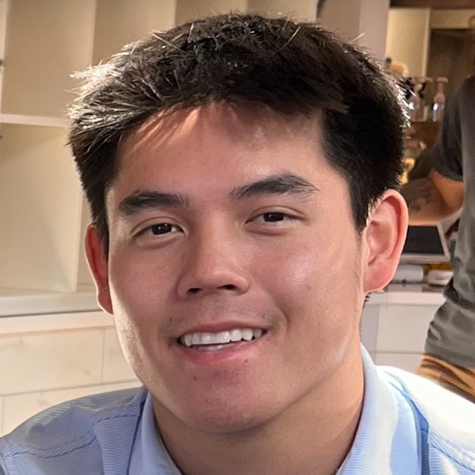
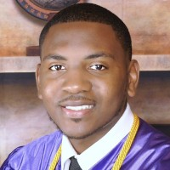
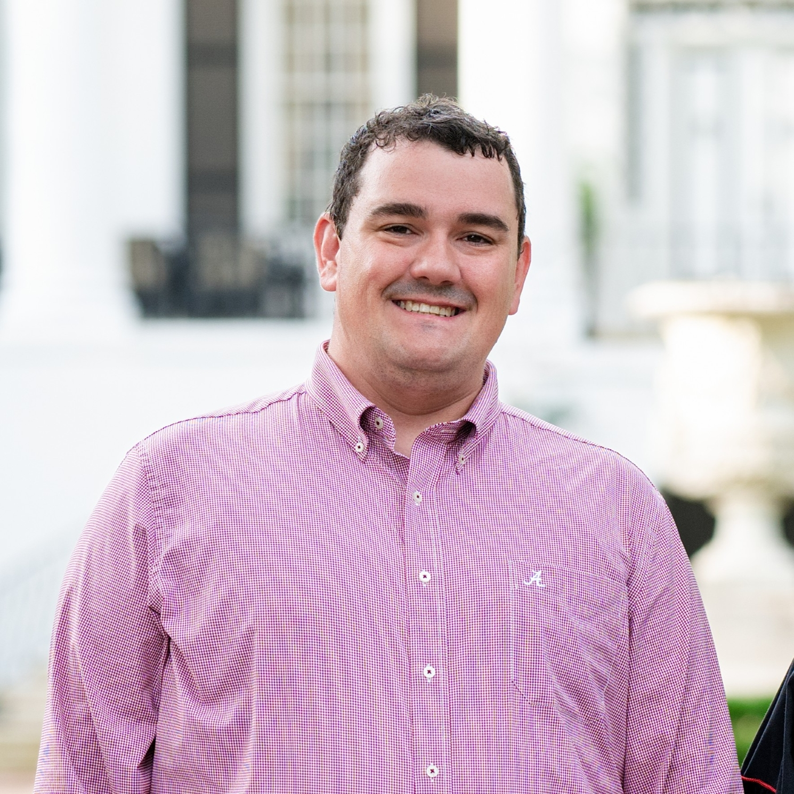
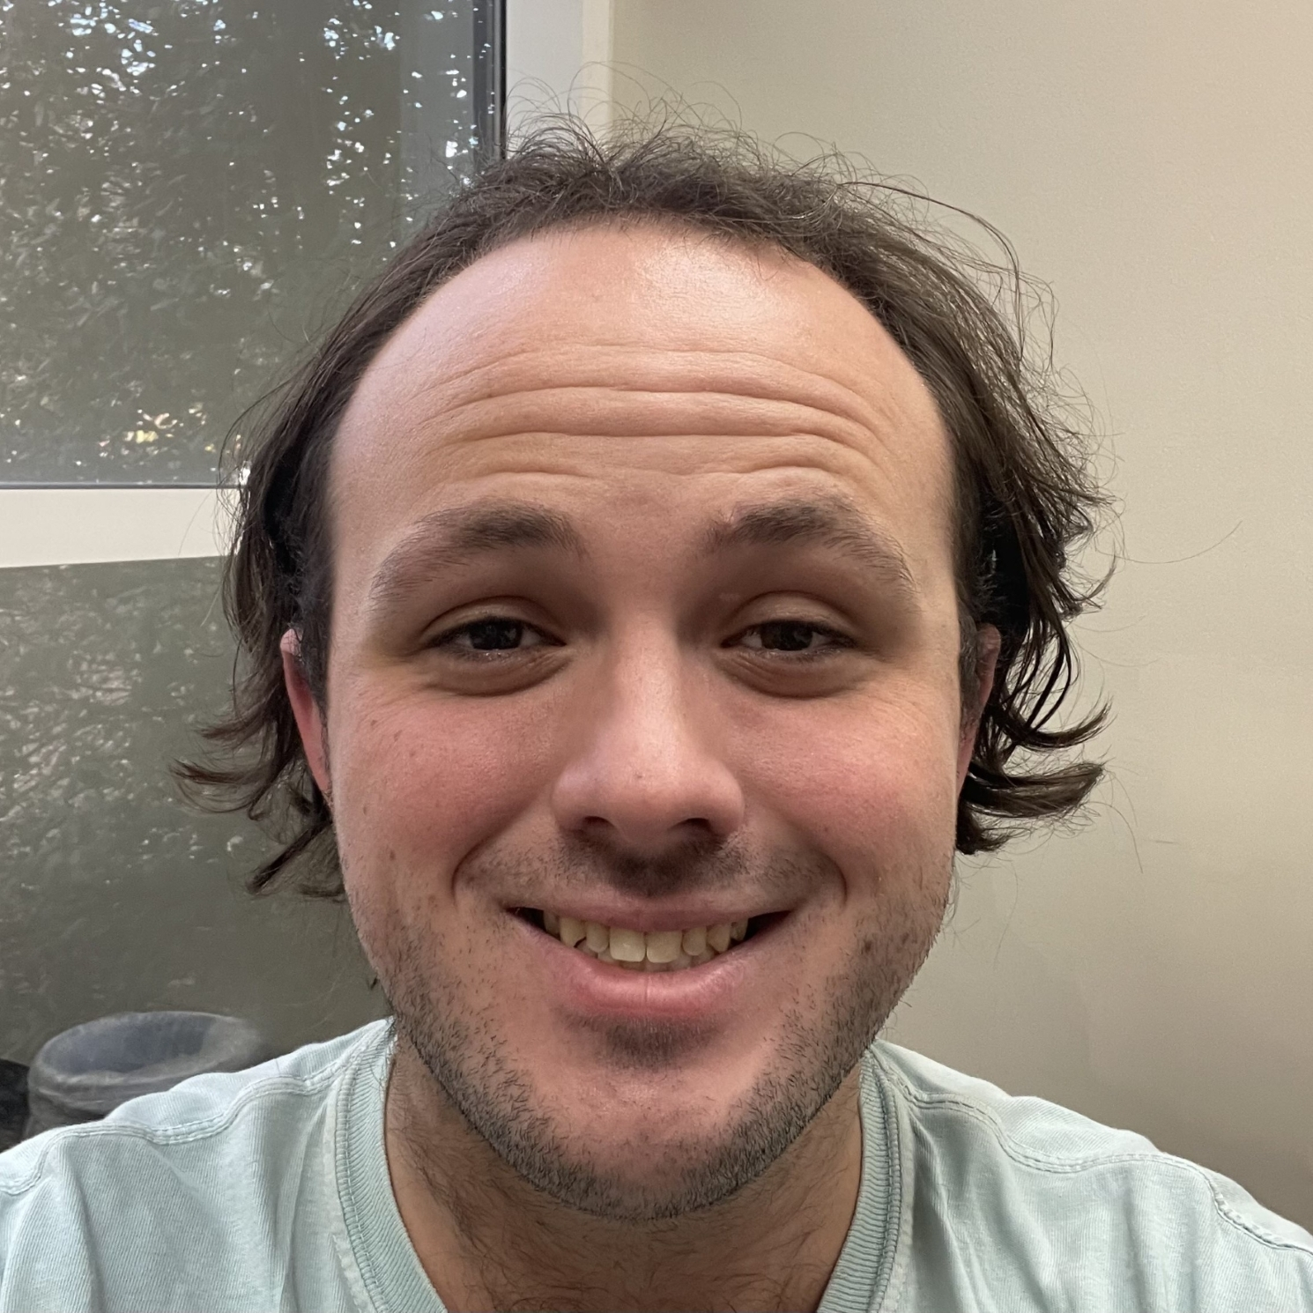
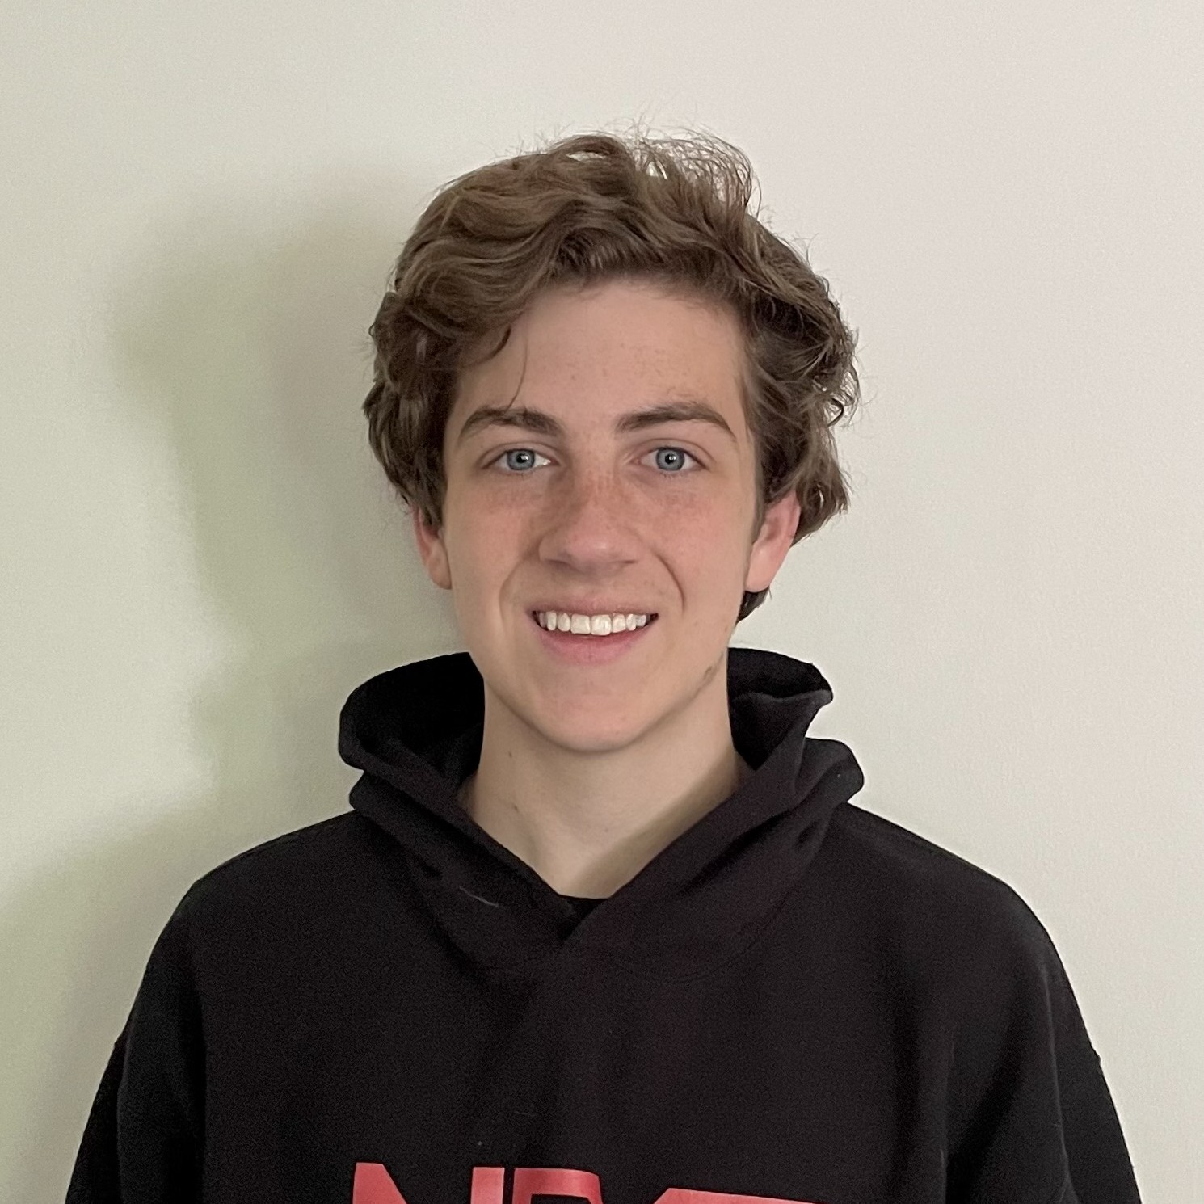
CoE Database
Sprint 3
Jacob Santos, Marcus Kelley, Andy Fancher, Brodye Stevens, Ethan Busby
Source Code Website
Project Website
Notes:
Jacob

Slide 2

Project Overview
Database for Connecting Alumni
Finding Jobs
Recruiting
Socializing
Responsive Website
Relational Database
Filter System
Login Security
Notes:
Jacob

Slide 3
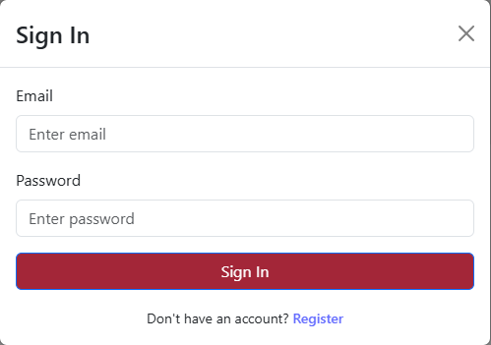
High-Level
Functionality
Database
Robust relational database stores all user data, profiles, and favorites in an organized structure with linked tables
Enables efficient searching and filtering of alumni information
Utilizes SQLite which is lightweight, free, and open-source
User Authentication
New users are able to create an account with their email & password
Secure login with JWT tokens for session management
Ability to sign-out to protect account security
Home Page
Displays current news and events from UA College of Engineering Website to keep alumni connected to campus happenings
Links to various pages that alumni may be interested in (Alumni Assn, etc.)
Notes:
Database-Brodye, User Auth-Ethan, Home Page-Marcus

Slide 4
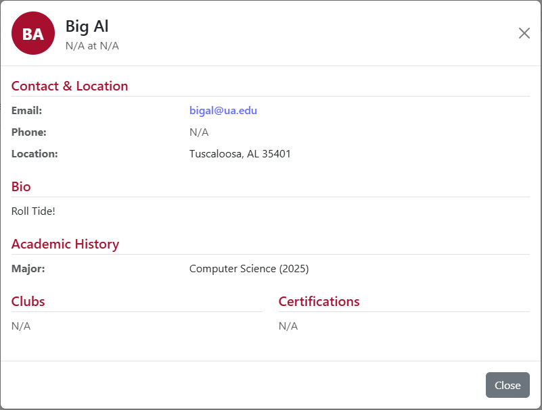
High-Level
Functionality
Profile Page
Allows user to include alumni information such as major, graduation year, etc.
Includes additional fields for any UA Clubs they were part of
Additional fields for current occupation and any professional certifications
Only information that is entered will be shared with other alumni
Networking
Robust search method allowing users to search for fellow alumni
Modular view that shows pertinent information with ability to view full profile
Option to add alumni as ‘Favorite’ for quick access to information in the future
Favorites
View all bookmarked alumni in a single place
Similar modular view to Networking Page for quick information
Users have ability to search for specific favorites
Allows users to edit/remove favorites as their network grows
Notes:
Profile-Brodye, Networking-Ethan, Favorites-Marcus

Slide 5
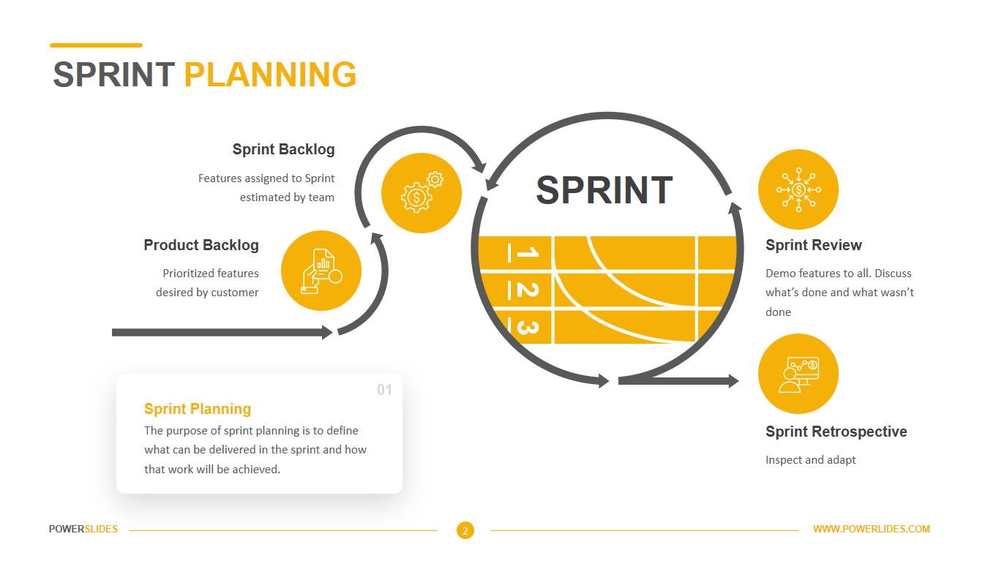
Backlog
Repository Transfer
Move project repository from personal account to an organization
This will allow better team access, branch protection controls, and ensure viability of long-term maintenance & development
Admin Account
Create admin user level with appropriately elevated privileges
Will allow user monitoring and engagement
Could also assist users with account issues (password resets)
Would also include user management, including potential bans
Profile Pictures
Enable users to upload Profile Pictures
This would help personalize their profile further and assist with recognition within Networking
Notes:
Andy

Slide 6
Project Demonstration
CoE Alumni Database
Notes:
Ethan

